Slide 1
The origins of TS mutations
A family-based genetic study invitation
Joseph Gleeson, MD
Professor, UC San Diego
Investigator, HHMI
Director of Neuroscience
Rady Children’s Institute for Genomic Medicine

Slide 3
Acknowledgements
Kari Luther Rosbeck
Steven L. Roberds, PhD
Jo Anne Nakagawa
Jaye Isham

Slide 4
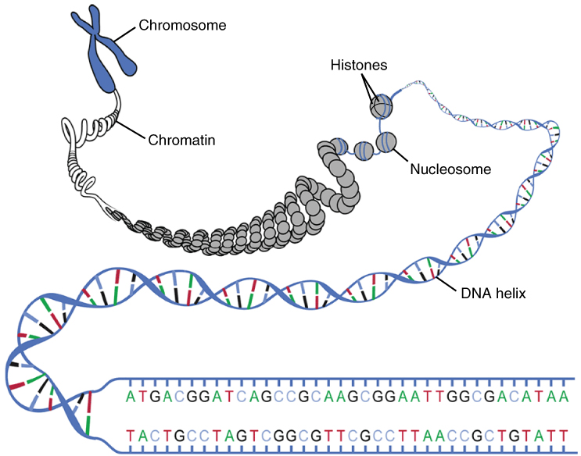

Genetic mutations can cause disease
ATGACGGAT
Deletion
ATGACAT
Insertion
ATGACCGGAT
Image from socratic.org
SNV
ATGTCGGAT

Slide 5
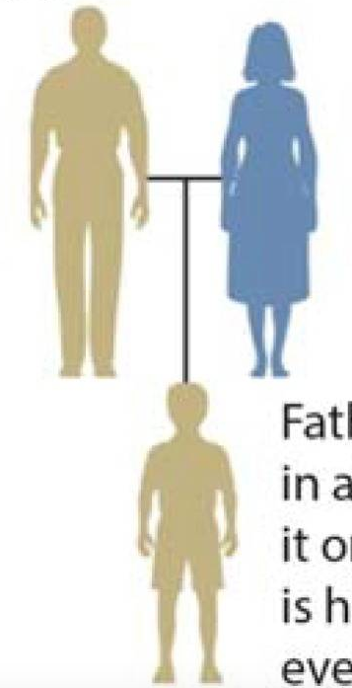
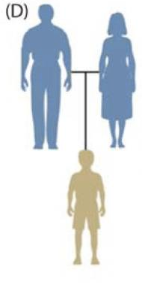
Mutations can be new, or inherited from parents
New
aka “de novo”
Inherited
Adapted from Freed et al., Genes 2014

Slide 6
De novo mutations
Zygote-stage
Paternal germline
Maternal germline
Adapted from Freed et al., Genes 2014
Notes:
Zygote is the one-cell stage of the new embryo, just after sperm cell and egg cell meet
Germline means either the sperm cells (for the father) or the egg cells (for the mother) have the mutation
These mutations are what we call mosaic

Slide 7

Mosaicism
Mosaic mutations are in some, but not all, cells in a person’s body
Very common; most will have little or no effect
Can only find mosaic mutations if you look in the right cells! (i.e. maybe not blood)

Slide 8
Mosaicism
Cancer
Germline
Notes:
While most mosaic mutations will not have an effect, some will.

Slide 9
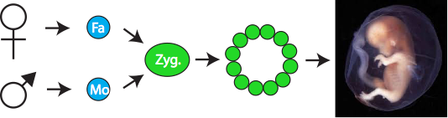
De novo genetic mutations (DNMs)
25-50% of neurodevelopmental disease due to DNMs.
80% of DNMs attributed to the father.
Transmitted DNMs double every decade in father.
Attributed to cell proliferation in sperm.
Kang et al. Nature 2012
Notes:
In the example of DNM, we think of these as occurring at the time of fertilization. In this model, father and mother contribute a healthy germ cell, where the mutation occurs. But we know from sequencing FMA pairs, again work pioneered by Matt State and others, #DNMs increases as a function of parental age. Specifically, paternal age has a huge effect on #DNMs in an offspring, as shown by Kari Steffanson. In this plot age of the father is plotted against #DNM in the offspring. How big is this problem? It is estimated that 25-50% of NDDs is due to DNMs. 80% of DNMs are attributed to the father’s chromosome. and #DNM transmitted doubles for every decade of paternal age. This is because sperm continue to divide through the life in males, which is not the case for females.

Slide 10
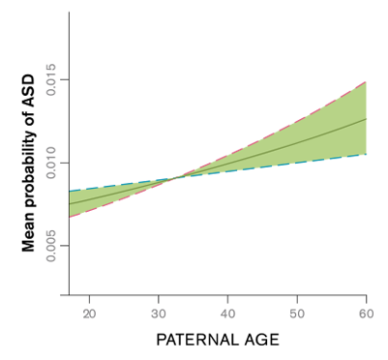
Paternal age increases disease risk
Adapted from Idling et al., Int J Epidem 2014

Slide 11
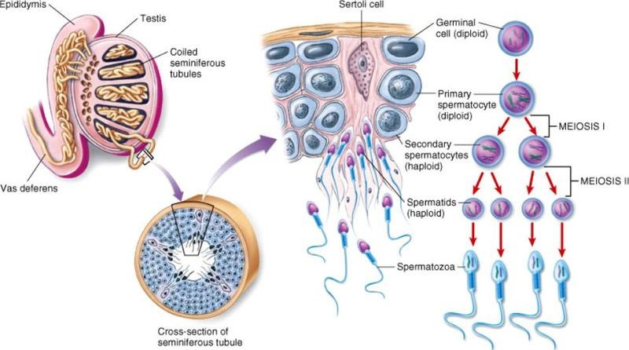
Some sperm mutations cause cell hyperproliferation, leading to clonal expansion

Slide 12
Recurrence
A mutation can recur in multiple children if it is inherited OR if a de novo mutation is from parental germline mosaicism
Adapted from Freed et al., Genes 2014

Slide 13
Recurrence Risk
For inherited (dominant) mutations, recurrence risk is 50%
For de novo mutations, genetic counselors might estimate a 1% recurrence risk based on many families.
For cases with paternal germline mosaicism, we can use sperm samples to assess exactly the percentage of cells that carry the disease-causing mutation.
Adapted from Freed et al., Genes 2014

Slide 14

Two example families
Mutation in 15% of sperm
Mutation in 0% of sperm
Notes:
Families with ASD and/or epilepsy diagnosis
Joe- consider telling the story of the left-side family

Slide 15
Tuberous sclerosis
TSC1 & TSC2 mutations can be inherited or de novo
Variable expressivity- the same mutation might cause symptoms in one person but no symptoms in another (e.g. in inherited cases)
TS-causing mutations are “loss-of-function”- TSC1 or TSC2 protein does not work anymore

Slide 16
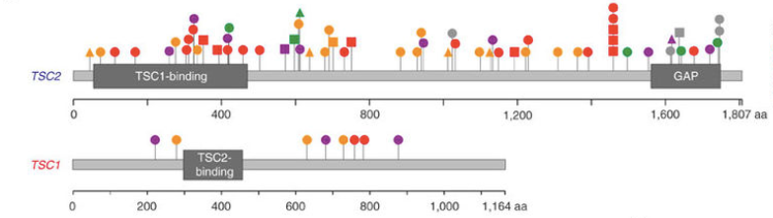
Tuberous sclerosis
Caused by mutations in two genes, TSC1 and TSC2
From Martin et al., Nat Comm 2017

Slide 17
Our study
  Questions:
    What percentage of TS cases have paternal germline mosaicism (in sperm cells)?
    For those cases, what percentage of sperm cells carry the mutation?
    A first step towards a genetic counseling tool for families to get a personalized risk assessment for recurrence

Slide 18
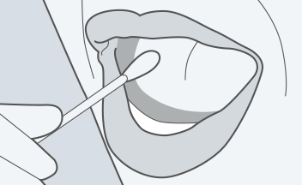
Who can enroll?
  Families of a child with genetic TS diagnosis that are willing to share a copy of the test results
  Father is willing to provide semen sample
  Both parents and child with TS are willing to send in a saliva sample (siblings also requested)
      Swab kits available for children with difficulty spitting

Slide 19
Our study: logistics
Confidential, no cost
We send out saliva collection kits and a semen collection container by mail
You collect all samples at home
You use the prepaid FedEx package to send samples back to us (or can drop off at the lab at UCSD)
$20 gift card token of thanks

Slide 20
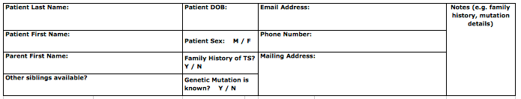
How to enroll
Sign up on the clipboard after this talk
OR
Email us: gleesonlab@ucsd.edu
OR
Call us: 858-246-0547

Slide 21
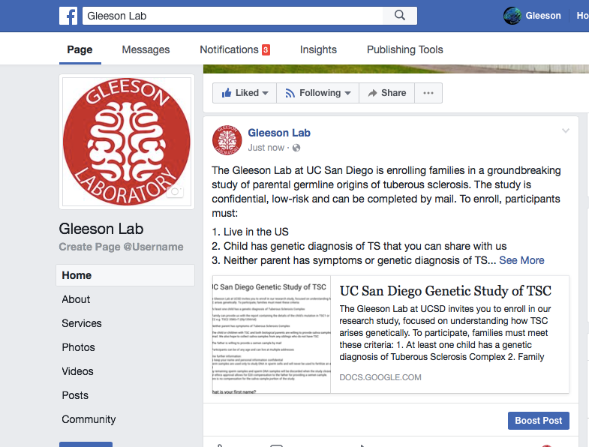

Slide 22
We need your help..
The success of this study depends completely on the partnership of families such as yours!
Please spread the word to friends and online support groups- share our Facebook announcement and the forthcoming announcement from the TS Alliance

