Slide 1

Medical Transition Guidelines and Toolkit
Rebecca J. Schultz, PhD, RN, CPNP
Assistant Professor
Baylor College of Medicine
Pediatric Nurse Practitioner
Comprehensive Epilepsy Program
Texas Children’s Hospital
TSC , New York, New York
October 13, 2017
Notes:
Text
Text
Text
Text

Slide 2
Disclosures
Up toDate® Rett syndrome
HRSA Grant #H98MC26262: “Emerging Strategies for Children and Youth with Epilepsy in Texas”

Slide 3
Everyone is my teacher. Some I seek. Some I attract because of what I must learn. You might be unaware of what you teach me. I bow deeply to you in my gratitude for what you have taught me.
Neeshia Jasmara

Slide 4
AT THE END OF OUR CONVERSATION TODAY I HOPE YOU WILL:
Understand the term medical transition
Understand your role in planning for a successful transition for your adolescent--set expectations
Utilize the transition toolkit to guide you through the transition process.

Slide 5
What is health care transitioning?
A dynamic process of moving from pediatric to adult health care system
  Prepare youth to receive care within the adult health care system. ** Includes caregivers
  Patient centered, developmentally appropriate, comprehensive, uninterrupted
  Transfer—an element of transition
Blum, R.W., et al. (2002).
Notes:
Transitions are a part of normal, healthy development and occur across the life span. Transition in health care is a dynamic process that seeks to meet the individual needs of children as they move from childhood to adulthood.

Slide 6

Goals of Health Care Transition
Maximize lifelong functioning and potential
  Promote self-advocacy, teach self-management skills
Prevent “bridge to no where”
  Good communication and uninterrupted services

Slide 7
Successful transition leads to . . .
Continuity of care
  Fewer gaps in clinical follow up
  Improved access to care
    Decreased financial barriers to care
Improved adherence
  Better seizure control
  Fewer emergency room visits
Improved Quality of Life
Annunziato, et al. (2007); Bryden, et al. (2001); Bryden, et al. (2003)

Slide 8

Needs of Adolescents with Chronic Health Care Conditions
Similar to transition for other youth
  Change as adolescent matures
  Desire for independence
  Need for identity and purpose
  Often complex
  Require individualized care
Notes:
The needs of adolescents with SHCNS are similar to those for other youth. They change as the adolescent matures but these youth desire independence, they need an identity and purpose—job---instill hope for future autonomy. But their needs are often more complex and require individualized planning.

Slide 9


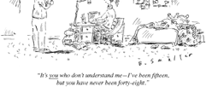



Relationships during Transition
Notes:
What makes transitioning so difficult? What factors are involved.
Stressful time for parents and the adolescent. Remember your adolescence? Or if you are a parent of an adolescent you may identify with some of these feelings. Psychoanalyst Erik Erikson wrote about development through the life span. Adolescence 12-18 years stage of identity vs role confusion. This is a time of experimentation.

Slide 10


Tasks of Adolescence
Autonomy
Identity
  Personal
  Sexual
Developing goals
  Educational
  Vocational
Engaging in intimate relationships
Notes:
Examine with a developmental lens.
The major tasks of adolescence are developing personal and sexual identity. Body image and peers become very important as they strive to validate and confirm ‘who they are’. The need to belong and conform leads to increased vulnerabilities.
Adolescence is a difficult time in development. Peers, emotions. . .
“Fidelity” is the key virtue to develop. In young adulthood there is conflict between intimacy and isolation. “Love” is a key attribute to develop.
Now, let’s take a look at what some adolescents are saying about how epilepsy impacts their life and how that interferes with these developmental tasks of adolescence.

Slide 11
Impact of Epilepsy on Adolescent Maturation
Autonomy
  “Think of the things that I can no longer do without supervision—take a bath, swim, stay up late, drink beer . . . .”
Body Image
  “The pills will make me fat. My hair will fall out.”
Camfield, P, Camfield, C., & Pohlmann-Eden, B. (2012).
Notes:
Add a chronic health condition onto these normal developmental milestones, an already difficult time in development. Now lets look at how epilepsy might impact these acquisition of these normal developmental milestones of adolescence. Why might epilepsy interfere with the normal maturation of adolescence?

Slide 12

Impact of Epilepsy on Adolescent Maturation
Peer group identity
  “No one will go on a date with me.”
  “What happens if I have a seizure at school and wet my pants?”
Identity
  “I am not supposed to do most of the things that my friends do—drinking, drugs, sex.”
Camfield, P, Camfield, C., & Pohlmann-Eden, B. (2012).
Notes:
Add comment about study and dating from Shafer and EFA

Slide 13

Adolescents with Cognitive Impairments
Cognitive ability impacts the transition process & outcome
  “Developmentally, she is 7”
  Independent living skills
  Additional support
  Adult provider to accept care
    35% no adult neurologist
Camfield, Gibson, & Douglass, 2011; Reiss, Gibson, & Walker, 2005; Ward, Mallett, Heslop, & Simons, 2003
Notes:
With intellectual disability normal independence is precluded; remains a “child’ Adolescents with cognitive impairments who possessed independent living skills could be successfully transitioned; however, they required additional support to compensate for their cognitive deficits. Moreover, for those families who had severely mentally retarded adolescents, finding an adult provider who would accept them into their practice and work collaboratively with them was markedly difficult. Survey of child neurologists: 35% indicated that lack of adult neurologist willing to care for adult with epilepsy and intellectual disability.

Slide 14
Understanding barriers
Patients, parents/caregivers unwilling to transition
Adult providers lack experience
Adult providers difficult to access
Difference in pediatric vs adult culture
Aging out, but still youth is unready/ unwilling to take adult responsibility
Insurance changes
Transportation/ Access
Patient seen by multiple providers without a medical home (fragmentation of care)
No time to discuss transition

Slide 15
CNF Transition Project Advisory Committee (TPAC)
Interdisciplinary team: child & adult neurologist, patient sibling, nurses, social worker, disease advocates
Consensus statement based on literature review and expert opinion
Development of 8 common principles to guide transition
  Vignettes to show generalizability across diverse conditions
Brown, et al, Neurology® 2016; 87:1–6
Notes:
Launched in 2014
Endorsed by American Academy of Neurology, Child Neurology Society, and the American Academy of Pediatrics
to outline the responsibilities, describe the challenges and provide practical mechanisms to support child neurologists in planning and coordinating medical transition of patients.”

Slide 16
Common principles
Your tool to setting expectations for yourself, your adolescent, and your neurology provider.
Notes:
Therefore, the common principles discussed by Dr. Brown were developed. We hope this is a tool that you can use to set expectations for yourself, your adolescent, and your neurology provider.

Slide 17

Notes:
Transition can be difficult; can feel like you’re alone, or falling off a cliff with no parachute. With planning and guidance the move from the pediatric to the adult health care system can be less stressful.

Slide 18

Transition Takes . . . .
Time
  locate resources
  learn new information
Advocacy
Tenacity
Notes:
Just like in building a bridge; you need many supports and resources to successfully move from pediatric to adult health care system

Slide 19

#1: START EARLY
Begin discussion at 12-13 years of age
  Ask your neurologist when you will have to transfer to adult care?
    18 years
    21 years
    Never
  Will they help you with this process? How?
Set expectations
  Obtain optimal independence
Notes:
Begin discussion at 12-13 years of age. This gives you time to prepare. Set expectations. You know your teen best. Talk to your teen. Encourage him/her to participate and take charge of their health needs. Don’t under-estimate the ability of your adolescent. Adolescents with intellectual disabilities can learn about their health condition or their medications. If they are not able to engage in this conversation due to their disability, think about where you want them to be in the future. Set aspirations high, but realistic. Will they attend college? If not, vocational job? Sheltered workshop? Home?
Develop a plan to meet these expectations. Who do you need on your team?

Slide 20
# 2 & 3: Self-Management Skills
Start early: 12-13 years
  Depends on teen’s abilities
  Align with “training” in independent living skills
    Advance with age/acquisition
Baby steps: Starts with YOU!
  Let your teen check-in for their clinic appointment
  You may be surprised what your teen CAN DO!
Notes:
Teaching self-management skills has been shown to improve adherence during HCT.
Learning self-management skills is a process; takes time. Again, start early—12-13 years of age is NOT to early. Start simple and gradually increase knowledge and responsibility. Re-assess annually.

Slide 21
Letting Go!
Moving from “Advocate to Ally” Eileen Forlenza
Tips to “letting go”
  Remember, it’s about your child; Not about you.
  Let go of the idea that your child will make the same choices as you did for them.
  Professionals need to ‘let go’ too.
    Encourage direct communication between your child and the provider
  ‘Letting go’ might look different for each of us as parents
Adapted from Janet DesGeorges, www.handsandvoices.org
Notes:
Letting go might look different depending upon child’s abilities. But, allow your child to perform at the top of his skills. You might be surprised how effective your role modeling has been. They learn advocacy, standing up for themselves, accountability, responsibility.

Slide 22

Assess & develop self-management skills
Teach your teen about their condition
  Name of condition
  Signs of illness
  Sex, drugs, alcohol
  Signs of emergency; when to seek medical attention
  Develop emergency plan

Slide 23
Emergency Plan
Medical Alert bracelet/necklace or tag
Wallet card
  Diagnosis, seizure type
  Medications
  Allergies
  Emergency contact information
  Medical contact information
ICE number on phone
  Can include additional information about medical condition under the contact details
Notes:
What does your emergency plan look like?
Medical alert bracelet? etc

Slide 24
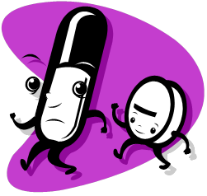

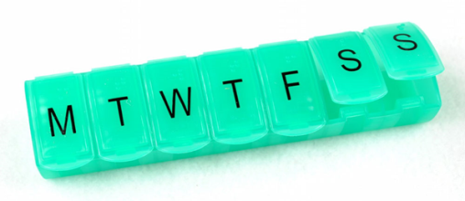
Managing Medications
Know names and doses of medication
Promote independence in taking medications
  Talk to provider about side effects
  Inconvenient dosing schedule
  Medication reminders
    Missed dose is #1 reason for breakthrough seizures
Know how to refill prescription
Notes:
Phone apps or pill box

Slide 25
Appointment Keeping
How to schedule an appointment
Importance of following up on lab tests, check-ups, referrals
Insurance coverage
  What to do if lose current coverage
  What does your health insurance cover?

Slide 26

Promote independence/self-advocacy
Encourage your teen to participate in the clinic visit
  Let them tell the doctor or nurse about their seizures; how they are feeling
  Let them answer the questions
  Encourage them to ask questions during the office visit
  Time alone in clinic visit

Slide 27
Readiness Assessment Tools
My Health : I know this/ I need to learn/ Someone needs to do this; Who?
  I know my medical needs
  I can explain my medical needs to others
  I know my symptoms including ones that I quickly need to see a doctor for
  I know what to do in case I have a medical emergency
  I know my own medicines, what they are for, and when I need to take them
  I know my allergies to medicines
www.gottransition.org
Notes:
There are several readiness assessment tools to document acquisition of self-management skills. Able to document when each skills is accomplished.

Slide 28
#4 Legal Competency
Age of majority is 18 years in most states
  Right and responsibility to make certain legal decisions
Assess decision-making capacity
  Begin discussion at age 14 years
Capacity for making decisions may vary depending upon your teen’s ability
  Shared decision-making
    Confidentiality waivers
    Health care power of attorney
  Guardianship
Notes:
Process can be time-consuming; 1-2 years. Expensive

Slide 29
Resources On Guardianship and Decision-Making Alternatives
www.thearc.org: “The Arc” for People with Intellectual and Developmental Disabilities
www.acf.hhs.gov U.S. Dept. of Health and Human Services, Administration for Children and Families, State Protection and Advocacy Agencies

Slide 30
#5 Comprehensive Plan – age 14
Education
  Review individualized educational plan (IEP)
  Develop school educational plan/support
    Remain in high school until 21?
    Group home
    College
Assess support needs
  Community resources
  Recertify for Medicaid by adult criteria
Health Care Providers
  Primary Care
  Specialists

Slide 31

#6. Transfer Packet
Between ages 17 and 18
    Assessment of youth’s knowledge of medical condition and self-management skills
    Decision-making capacity
    Prepare Transfer packet
      Summary of diagnosis/etiology
      Current medication/laboratory results
      Previous treatments and diagnostic evaluations
      Significant past procedures
      Protocol for emergency care
Brown, et al, Neurology® 2016; 87:1–6

Slide 32
Tracking
Resources
  Medical Summary and Emergency Care Plan
    www.gottransition.org
  Texas Parent to Parent Care Notebook
    www.txp2p.org
  Portable Health Summary
    https://www.sickkids.ca/myhealthpassport/

Slide 33
#7. Identify adult provider
Finding a new provider
  Referral from current provider
  Friends/family
  Health insurance directory

Slide 34
#7. Identify adult provider
What are your needs/expectations?
  Location
    Near home or at college
    Transportation needs
  Hospital affiliation/emergency care
  Knowledgeable about epilepsy/co-morbid conditions
  Communication style

Slide 35


Going to College?
Check out student health center services
  Health care provider on campus?
  Refills?
  Consider mail order pharmacy
Develop emergency care plan
  Share with roommate or resident advisor
  Post seizure first aid on dorm fridge or door
    Stopwatch
  Wear medical alert bracelet
  Program ICE into phone

Slide 36
Health Insurance
Insurance coverage
  Will it change?
  Parent’s plan until 26 years of age
Medicaid
  Will it change?
  Do your providers accept your plan?
  CHIP coverage ends after the 18th birthday
  Assistance
    Social Security Administration
    www.healthcare.gov

Slide 37
#8. The Transfer
Request current provider send a copy of medical records
Request current provider send a summary of their recommended treatment
Schedule appointment
Call new provider’s office before 1st visit to be sure they received records

Slide 38
Group Activity
Close eyes and keep closed throughout this activity
Fold paper in half
Tear off right hand corner
Fold paper in half
Tear off left upper corner
Fold in half
Tear off right hand corner
Open paper
Notes:
All papers will look different. This is like transition. The process is unique and individualized to each person.

Slide 39
Transition Toolkit http://www.childneurologyfoundation.org/transitions/

Slide 40
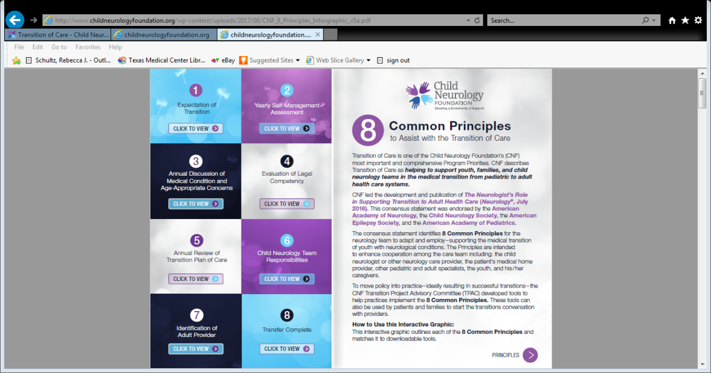
Downloadable Tools

Slide 41
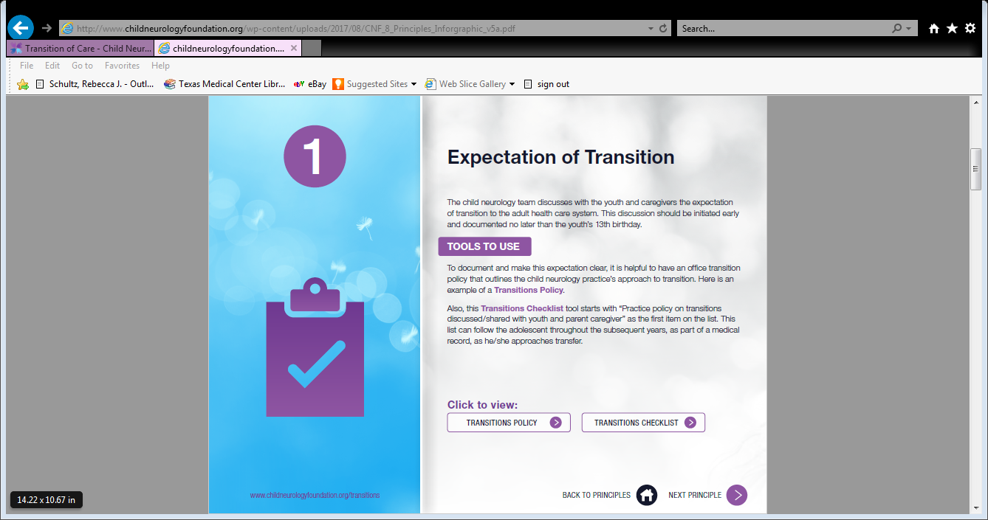

Slide 42
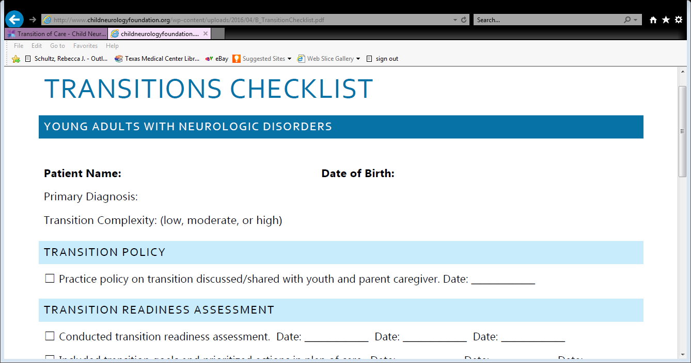

Slide 43
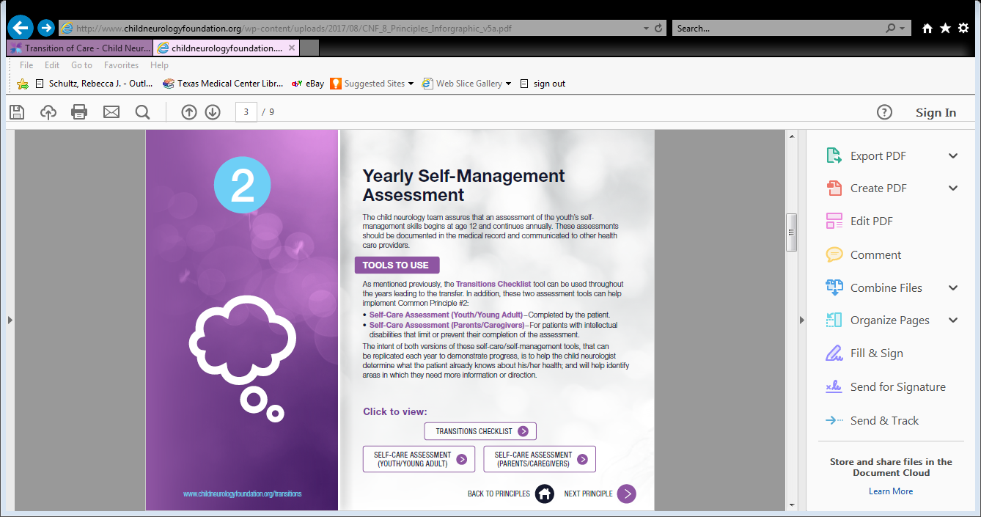

Slide 44
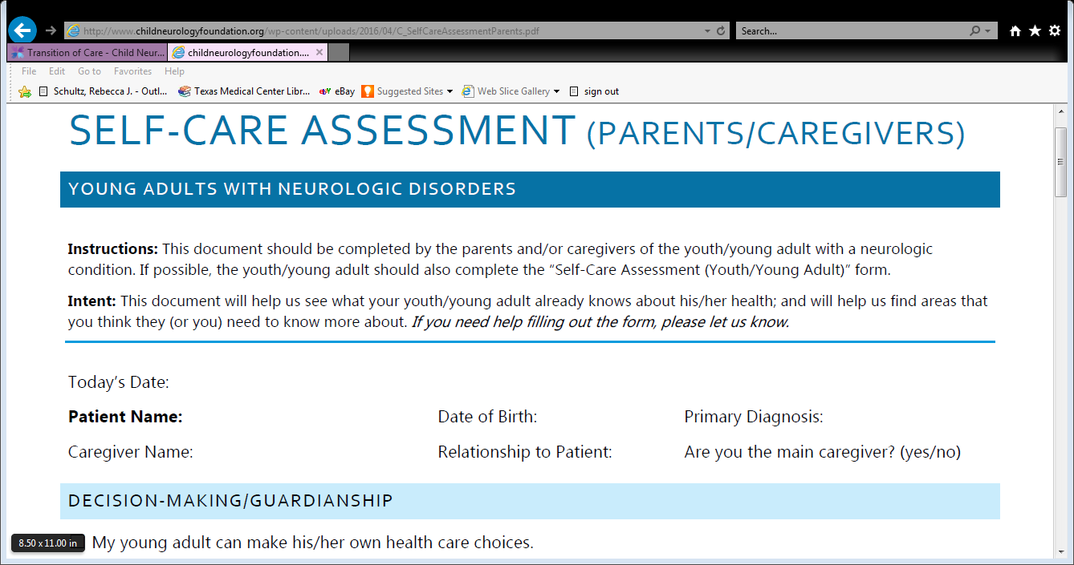

Slide 45
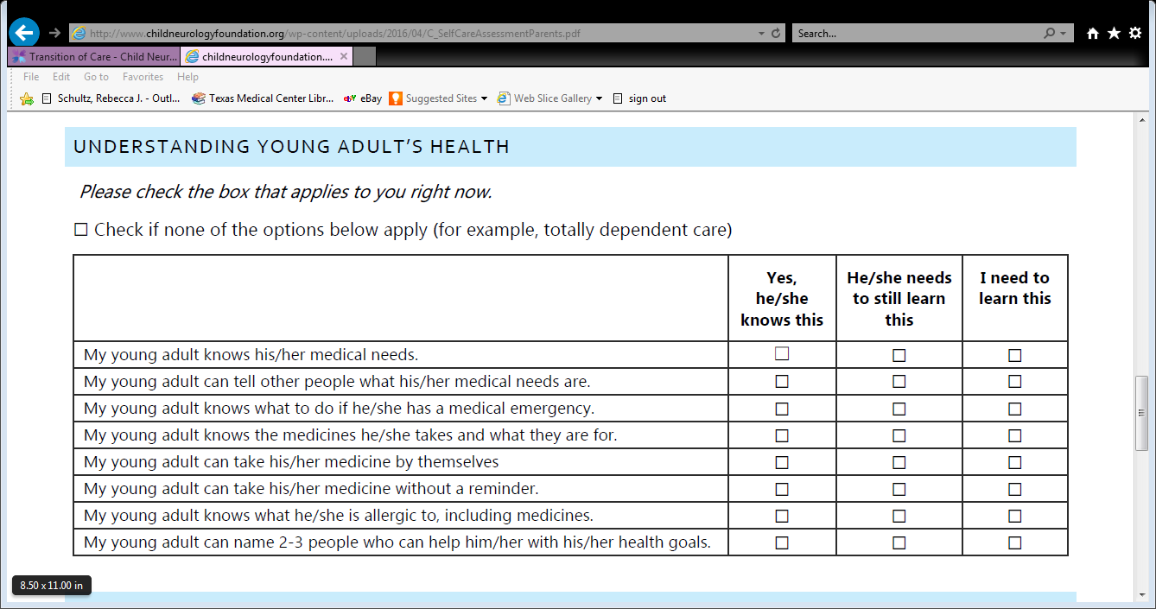

Slide 46
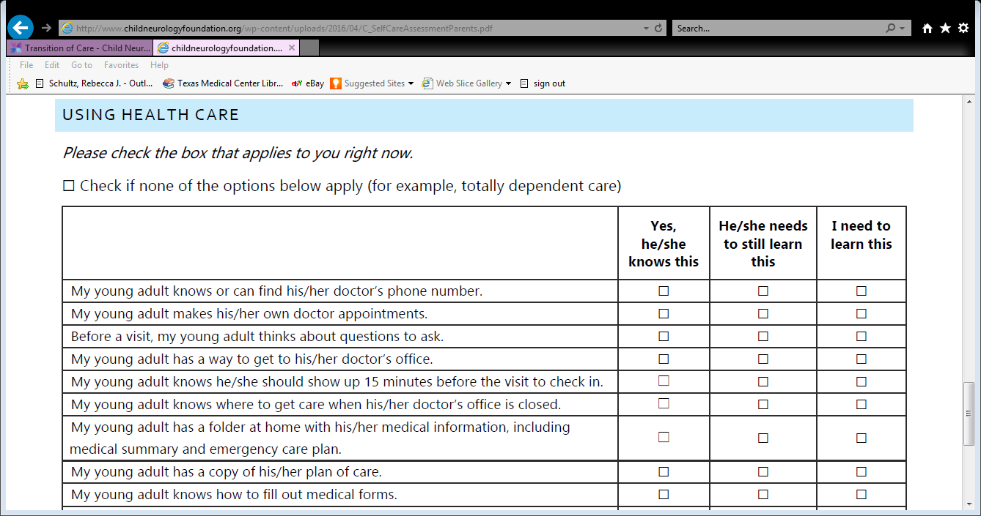

Slide 47
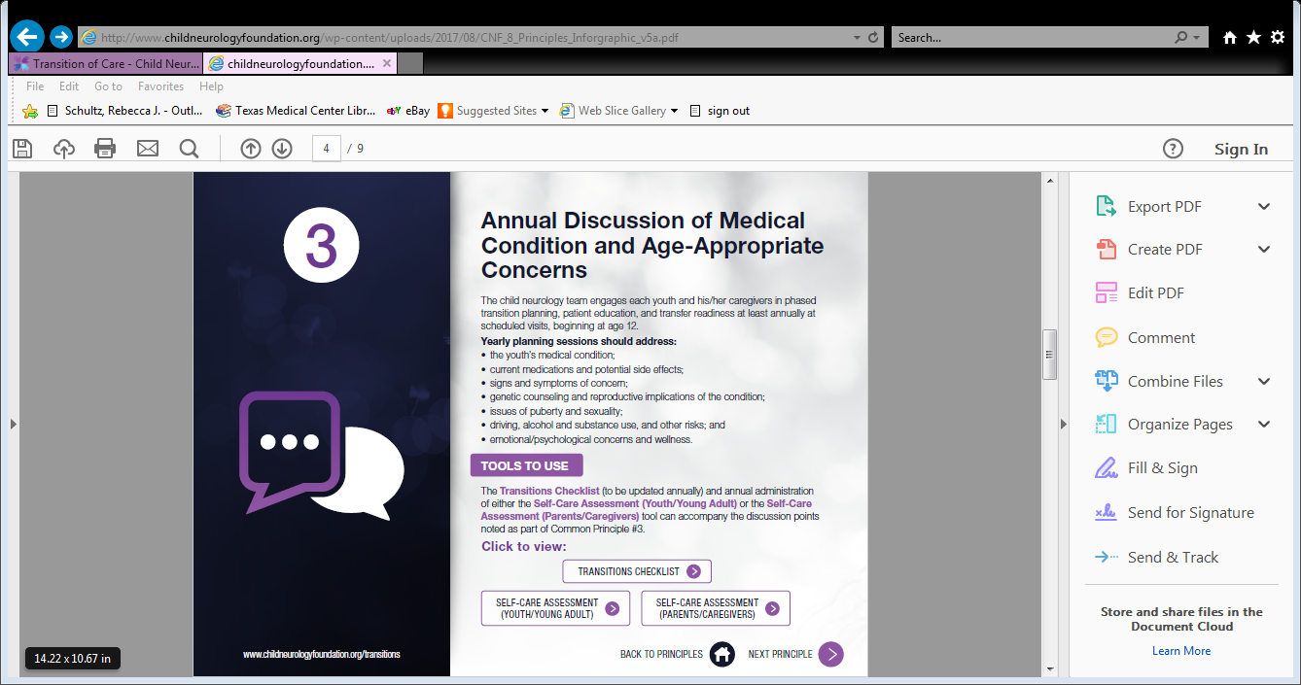

Slide 48
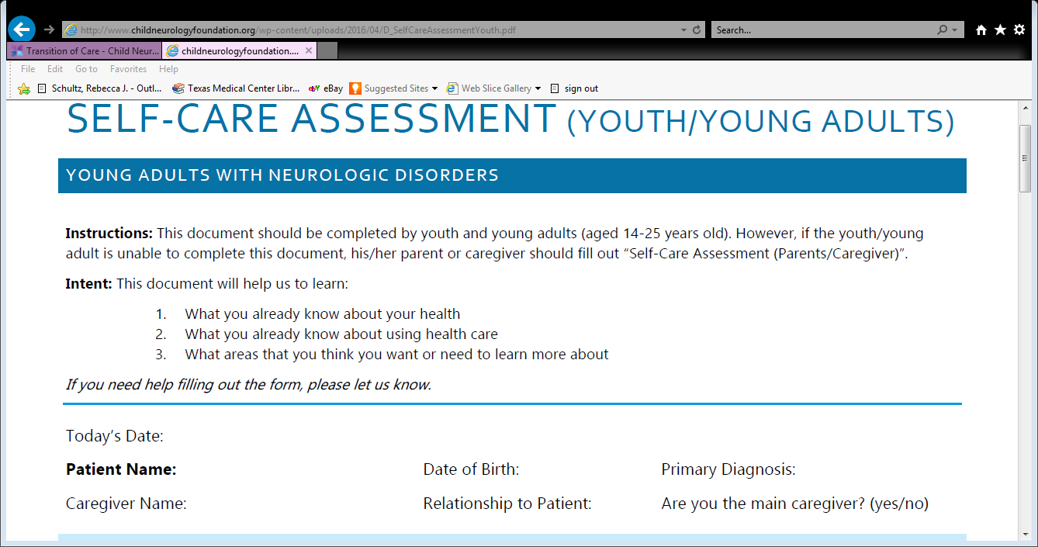

Slide 49
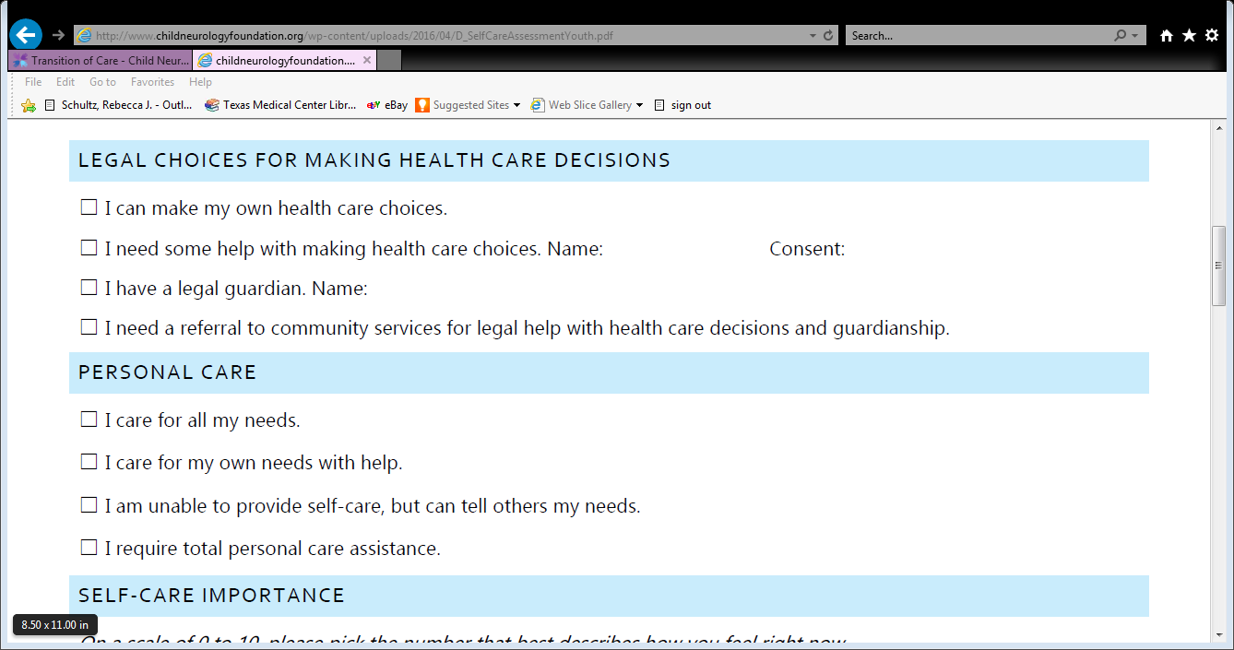

Slide 50
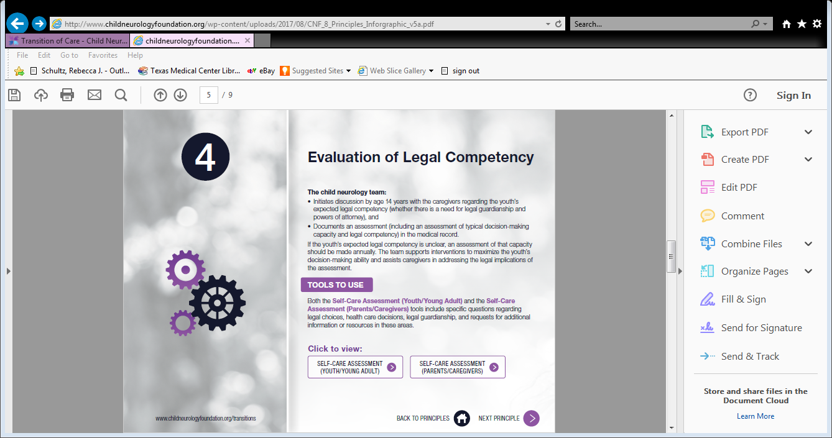

Slide 51
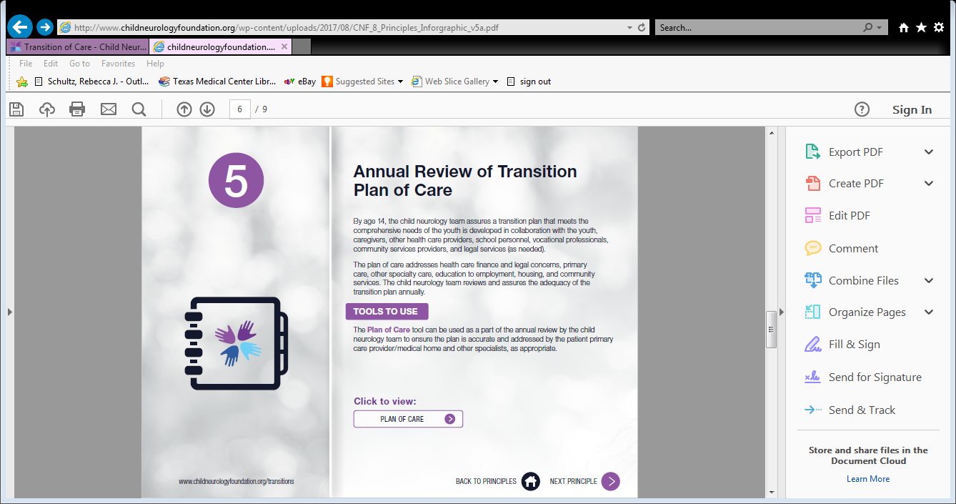

Slide 52
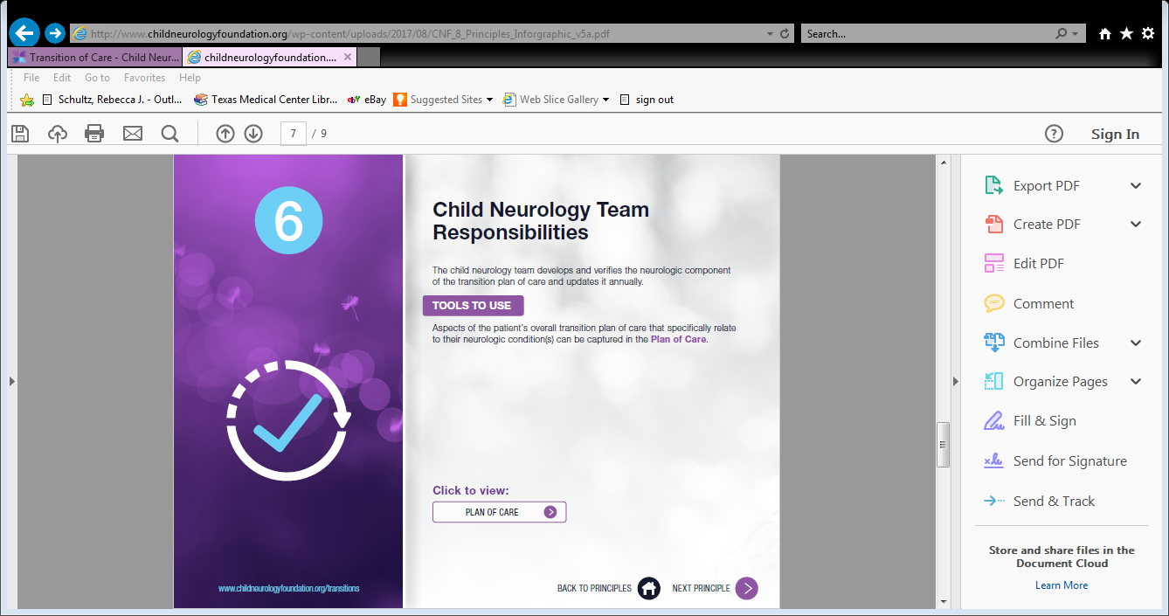

Slide 53
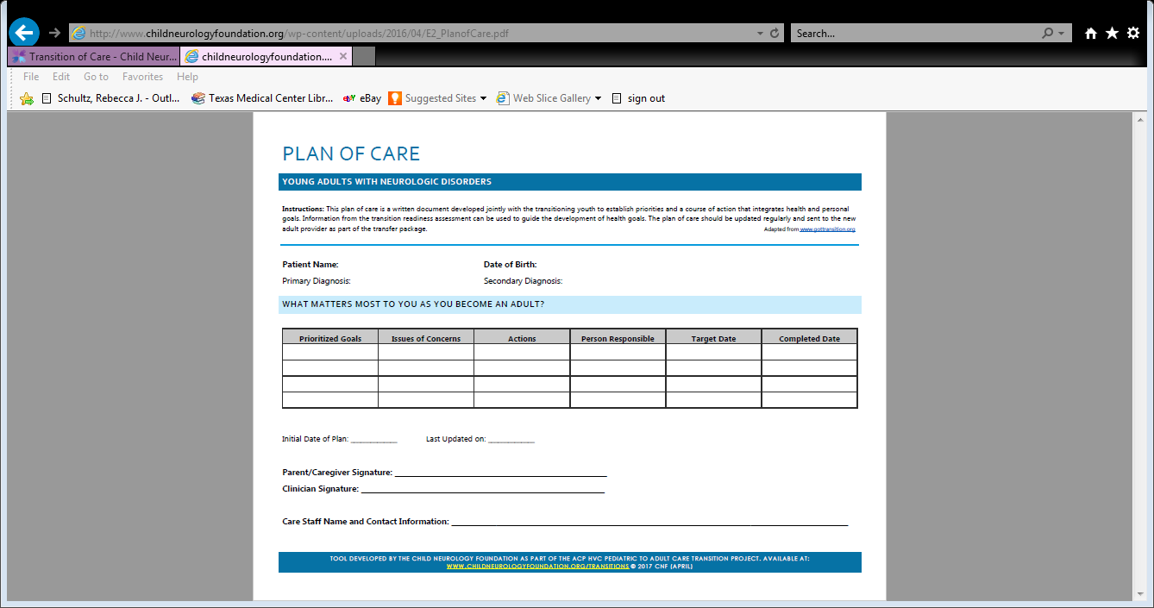

Slide 54
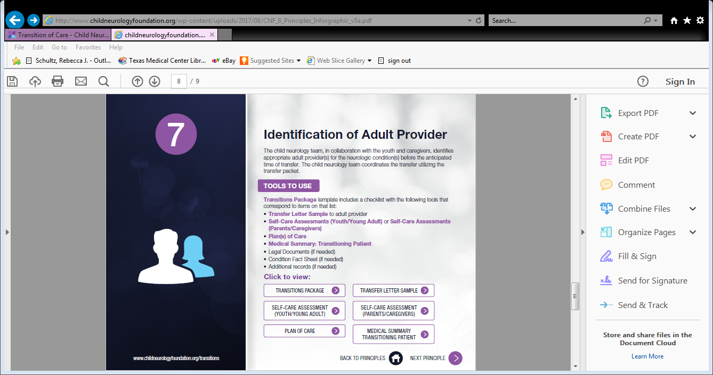

Slide 55
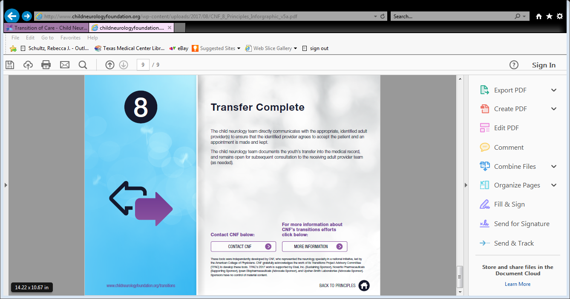

Slide 56
Summary
Transition is a process
Planning for the future is essential
Start early
Takes time to learn self-advocacy and self-management skills
Journey of Advocacy >>>> Ally
Goal to maximize lifelong potential

Slide 57
On Tuesday - Set Your Expectations!
Stay informed:
  http://www.childneurologyfoundation.org/transitions
  www.gottransitions.org
  www.medicalhomeinfo.org
Begin dialogue with self, family, and youth regarding transition expectations (health care vs. social). How do you envision the future? What is your dream?
  Begin dialogue with your provider regarding transition expectations
  Reach out to your community – YOU ARE NOT ALONE!

Slide 58

Thank you!

