Slide 1
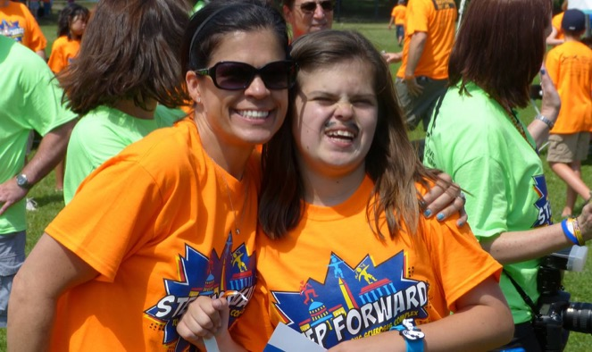
Transition from School to Community
Dena Hook, Vice President of Outreach
dhook@tsalliance.org

Slide 2
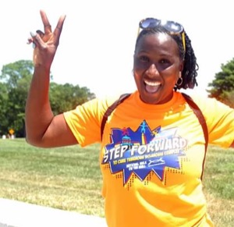
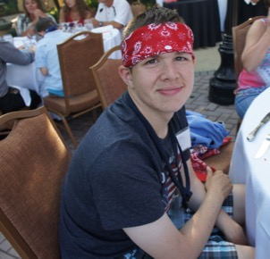
Answers to the Following:
Transition from School to Community . . .
What is Transition in IDEA?
What is Your Responsibility?
What is the School’s Responsibility?

Slide 3
A Post on Inspire . . .
Transition from School to Community . . .
”My TSC daughter graduates next month (age 21). We are absolutely without a plan for the next step. Vocational Rehabilitation Services isn't going to do much. Might find her a meaningless job. No skills training. Anyone know of resources I should be tapping into? Ideas?”
Who Dropped the Ball?

Slide 4
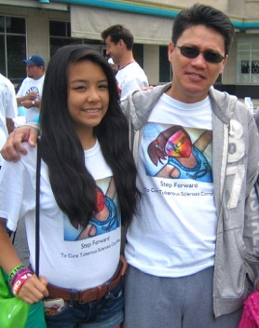
Federal Law (IDEA) is Clear:
Transition from School to Community . . .
“Our national policy of ensuring equality of opportunity, full participation, independent living, and economic self-sufficiency for individuals with disabilities “ [20 U.C.C.1400(c)(1)]
“Preparing children with disabilities to lead productive and independent adult lives, to the maximum extent possible” [20 U.S.C. 1400(c)(5)(A)(ii)]

Slide 5
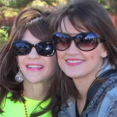
IEP Transition
Transition from School to Community . . .
Needs to be addressed at age 16 (or earlier if needed)
Student Involvement http://www.selfadvocacyonline.org/learning/
Data from vocational, medical, psychological assessments
A plan that includes functional and academic progress goals
Results-oriented moving from school to post-school activities
Multi agency involvement
Vocation Rehabilitation Services
Local “The Arc”
DD Council (Case Worker)
Independent Living Centers

Slide 6
What is Your Child’s Vision
Transition from School to Community . . .
Vision
What Are Your Child’s Present Levels In:
Academics?
Functional Skills (Living Skills)?
Present Levels
IEP Transition Plan

Slide 7
How to Work with Your School System
Transition from School to Community . . .
What is Your Perception?
What Do You See?

Slide 8
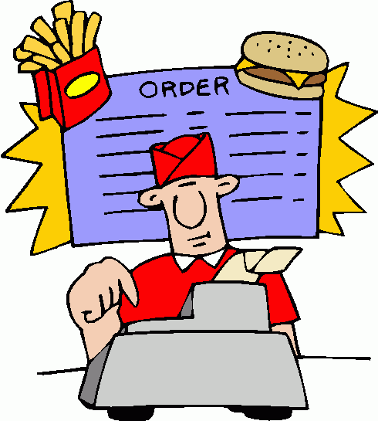
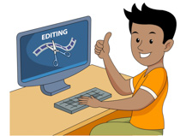
Just Like Perceptions, Visions Can Be Different
Transition from School to Community . . .
School
Parent
Student
Whose Vision Comes First?

Slide 9
How to Work with Your School
Transition from School to Community . . .
Aggressive communication is a method of expressing needs and desires that do not take in to account the welfare of others. Those who communicate in an aggressive manner are generally perceived as selfish and unwilling to compromise.
Assertiveness is a form of communication in which needs or wishes are stated clearly with respect for oneself and the other person in the interaction.

Slide 10
What is Your Child’s Vision?
Transition from School to Community . . .
Know Your Child’s Vision
Know Your Child’s Present Levels of Performance
Have High Expectations
Bring Suggestions/Solutions (Think Outside the Box)
Be Assertive, Not Aggressive

