Slide 1
The Trust-TSC Phase 3 Clinical Trial for Seizures in TSC
Mary Kay Koenig, MD
Associate Vice Chair for Clinical Research
Co-Director for the Tuberous Sclerosis Center of Excellence
Department of Pediatrics
Division of Child & Adolescent Neurology
University of Texas McGovern Medical School

Slide 2
Let’s start with clinical trials

Slide 3
What is a Clinical Trial?
A clinical trial is a research study that evaluates some type of medical intervention, like a medicine, in people to determine if it is safe and effective
Typically, before a clinical trial begins, the intervention is tested in a laboratory and in animals to determine that the therapy shows potential to be effective and is safe

Slide 4
Phase II Clinical Trial
A Phase II trial is designed to obtain preliminary information on whether or not the intervention is effective
These studies are typically small and usually everyone receives the treatment

Slide 5
What is a placebo?
A placebo is an inactive substance that looks like the drug being tested but has no effect
When performing a clinical trial, researchers want to be as certain as possible that any changes seen result from the treatment
To be certain, study subjects are divided into two groups, one who gets the treatment and one who get the placebo, then compare the results in the two groups
Typically no one, not even the research team, knows who is getting the treatment and who is getting the placebo

Slide 6
Phase III Clinical Trial
A Phase III trial is larger than a Phase II – it is designed to gather more information about the safety and efficacy of the intervention
This phase almost always involves a placebo arm
For rare diseases, the Phase II trial is sometimes skipped and researchers combine the Phase II & III trials
If this trial demonstrates positive results, the FDA may approve the therapy allowing its widespread use

Slide 7
What happens when a clinical trial ends?
Once the trial is over the researchers analyze the study data to determine if the treatment was effective and safe
The researchers then decide to either
  Ask the FDA for approval of the treatment
  Perform additional studies
  Stop investigating the treatment

Slide 8
Open-Label Extension
Some studies have “open-label extension” arms that allow you to continue on treatment or switch to treatment if you were on placebo.
You should ask about this BEFORE enrolling in a clinical study to determine if the study offers this option and for how long.

Slide 9
Why should I participate in a clinical trial?
Clinical trials, even failed trials, lead to advances in therapies
Clinical trials give you access to new treatments
Being in a clinical trial often provides for increased access to an expert medical team
Clinical trials may help others who have TSC

Slide 10
Now, Let’s talk a little bit about seizures

Slide 11
Brain connections
Brain cells, neurons, are close to each other so they can communicate
But, neurons don’t actually touch - there is a space between them called a synapse
A signal is carried across the synapse by either a chemical or an electrical signal

Slide 12
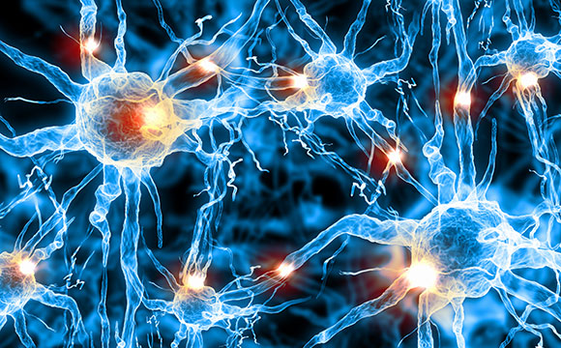
What is a Seizure?
A seizure occurs when you have an
uncontrolled surge of activity across
the synapses in your brain, like a power surge
The affected brain cells, or neurons, fire uncontrolled signals to other brain cells that are nearby overloading the affected area
Depending on the “normal” function of the part of the brain affected by this surge, the seizure manifests as different symptoms

Slide 13
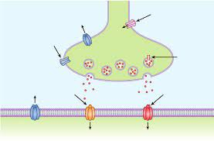
How do medicines treat seizures
Anti-seizure medicines work by altering
levels of chemicals at the synapse to block the power surge
Different medicines do this in different ways
  Block the sending cell from sending the signal
  Block the signal from reaching the receiving cells
  Affect the amount of signal that is present or how long it is present
Some medicines work better for some kinds of seizures than others, depending on why a particular patient is having seizures in the first place

Slide 14
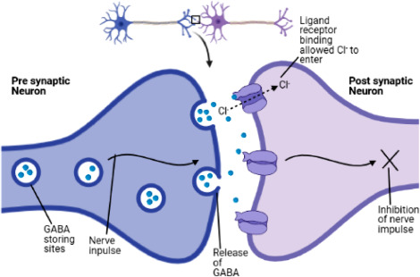
GABA
GABA is used to “fine-tune” transmission
between brain cells at the synapse
GABA works by inhibiting, or blocking, transmission of a signal between nerve cells, making them less excitable
A lack of GABA is one reason why someone might have seizures
Even if it is not the cause of the seizures, increasing GABA can sometimes slow down or stop a seizure by blocking overexcitement in the brain

Slide 15
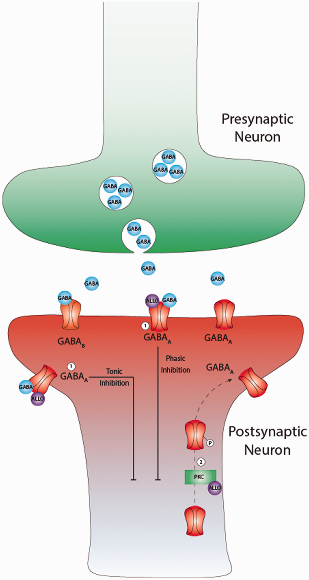
What is ganaxolone?
Neuroactive steroid that binds to the GABA receptors in the brain to increase GABA signaling and inhibit electrical impulses between synapses

Slide 16
The calm study
A Phase II Open-label clinical study evaluating oral ganaxolone for the treatment of seizures associated with TSC

Slide 17
CALM study
23 patients received ganaxolone at 7 sites in the US
These were very refractory patients having an average of 77 seizures per patient in the 28 day baseline period (2 to 3 seizures per day)

Slide 18
CALM study
The plan was for all 23 to undergo 4 weeks of titration followed by 8 weeks of treatment
  17 patients completed the study
  6 withdrew (seizures, sedation, diarrhea, angioedema)
Patients (or their caregivers) recorded the frequency of seizures

Slide 19
CALM Study Results
The average reduction in seizure frequency was 16.6%
About 1/3 of the patients had at least a 50% reduction in their seizure frequency
The most common side effects were somnolence, fatigue and sedation
Based on the results of this study, a Phase III study was developed & is currently underway

Slide 20
Trust-tsc
TReating Uncontrolled Seizures in Tuberous sclerosis complex
A Phase III study investigating whether ganaxolone has the potential to reduce seizure frequency in TSC

Slide 21
TRustTSC – Enrolling Now
Global Phase 3 placebo-controlled study of ganaxolone in children & adults with TSC
4 week baseline period
16 week (4 month) blinded treatment phase
Followed by open label extension phase (for those who choose to continue)

Slide 22
TRust-TSC – Inclusion Criteria
Ages 1 to 65 years with Tuberous Sclerosis Complex
Inadequate seizure control with attempts of at least 2 previous seizure medications
For more information on how to enroll visit www.trusttsctrial.com or search “TrustTSC” at www.clinicaltrials.gov

Slide 23

Thank you!
TSC

